Slide 1
Military Spending
Jessica Fogerty
DATS 6103 Section 10

Slide 2

Overview
Countries: US, China, Russia, Germany, UK, France, Italy, Iran, Israel, Saudi Arabia
Years: 2012-2017
Objectives:
Compare the data to the countries GDP
Compare the data to the overall military spending of all the 10 countries
Compare the per person Military spending to per person GDP
Single out the fastest growing countries in military spending in fixed value and percent.

Slide 3
Data Sources
SIPRI Military Expenditure Database
www.sipri.org
GDP and Per Capita GDP
www.data.worldbank.org

Slide 4
Learning Outcomes
Learned how to clean data in Python with Pandas
Dropped columns and rows, changed column names, joined tables.
Perform operations on data
Learned how to plot data in various ways with matplotlib

Slide 5
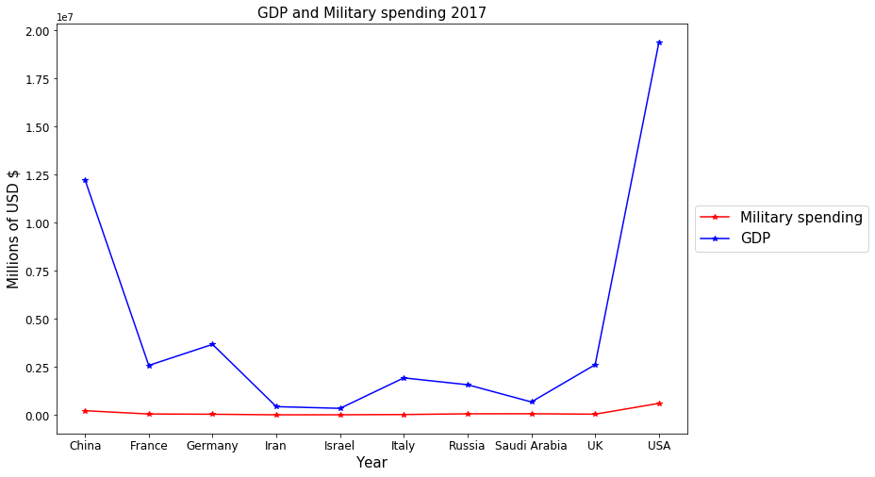
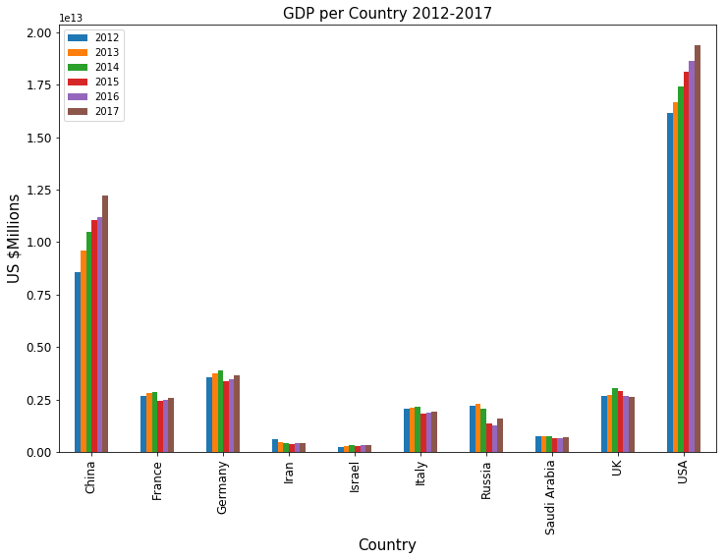
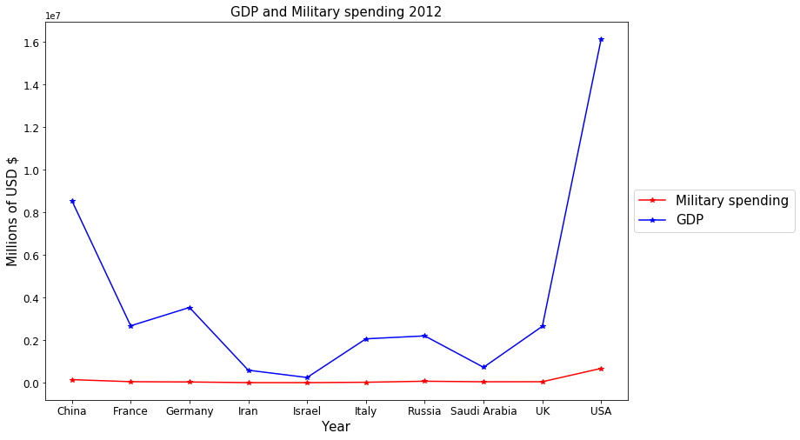
Military spending compared to gdp

Slide 6
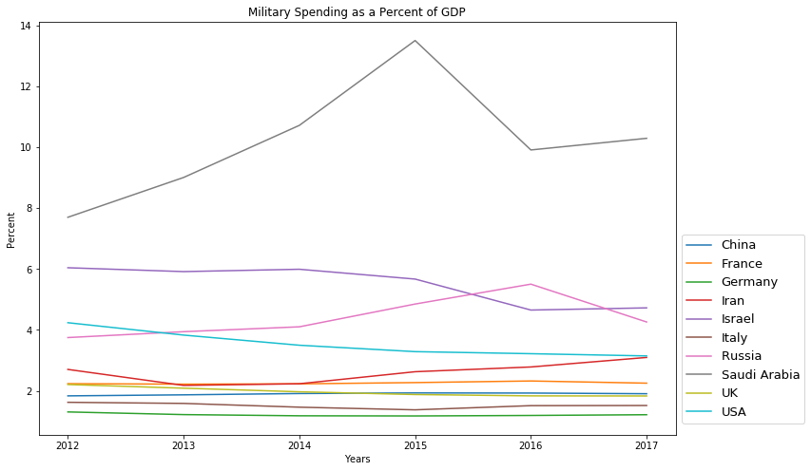
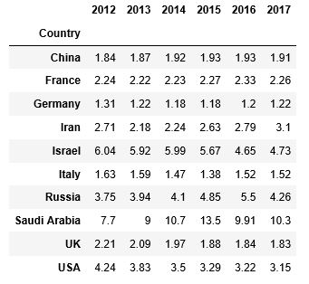
Compare the data to the countries GDP

Slide 7
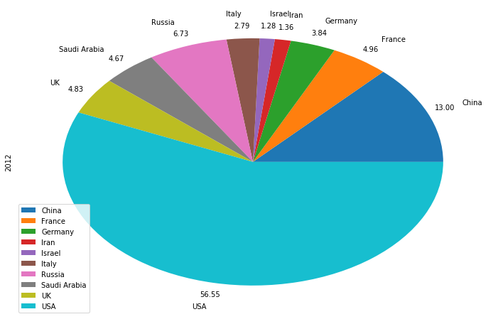
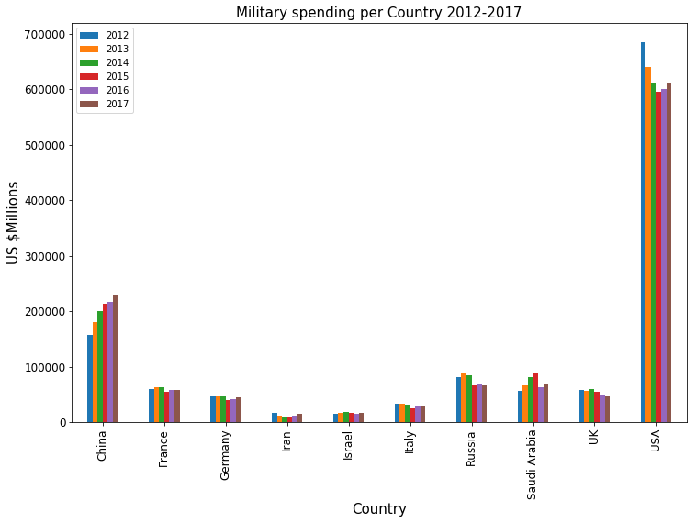
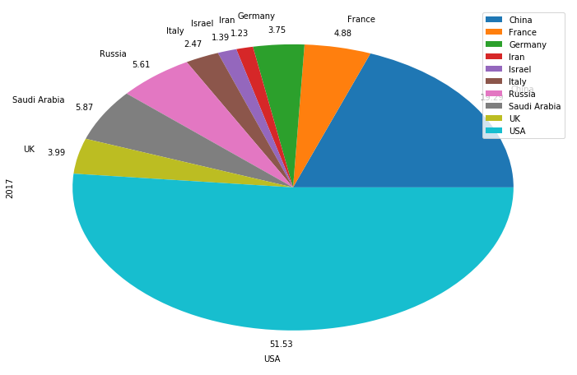
Compare the data to the overall military spending of all the 10 countries
In constant $us millions

Slide 8
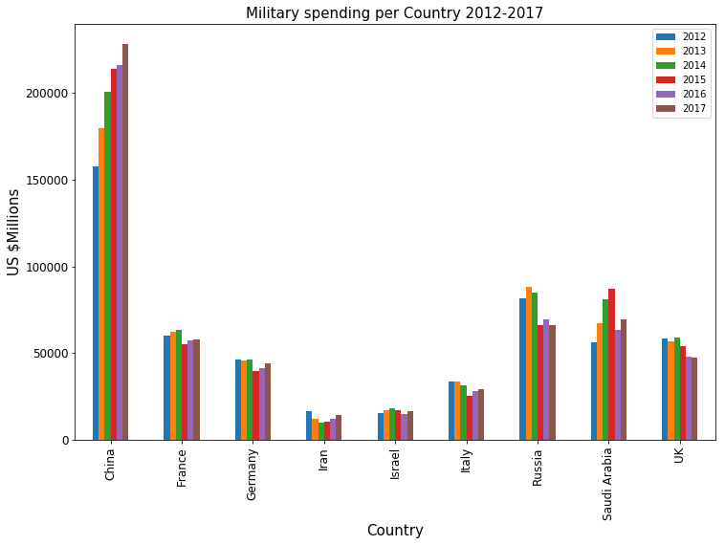
Military Spending Per country per year -excluding the US-

Slide 9
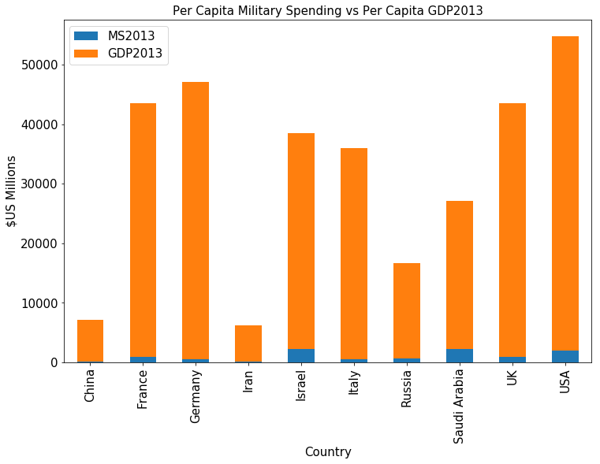
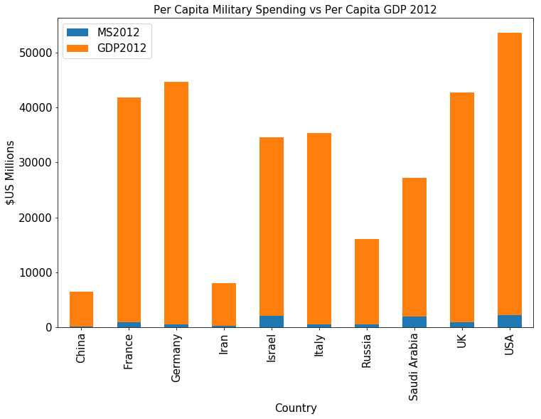
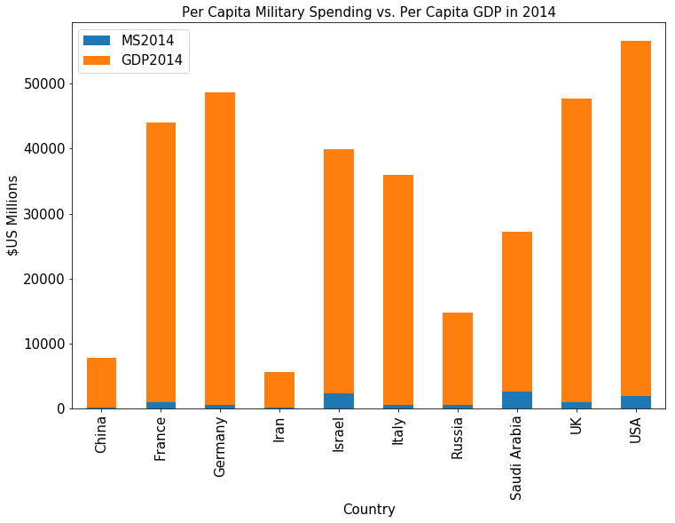

Slide 10
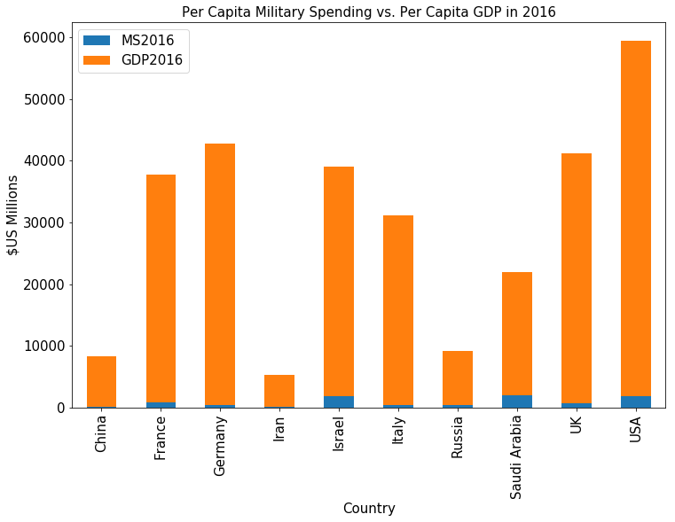
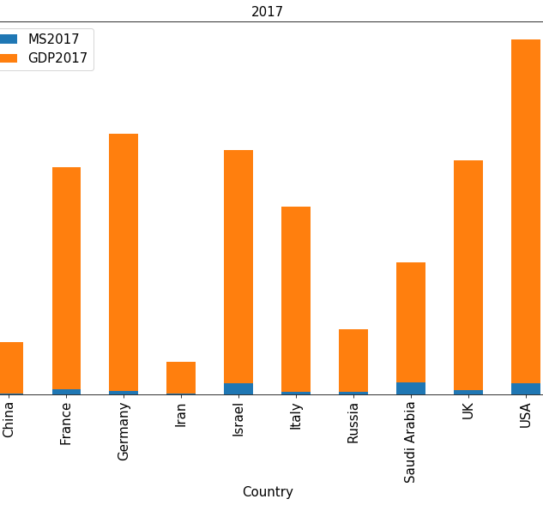
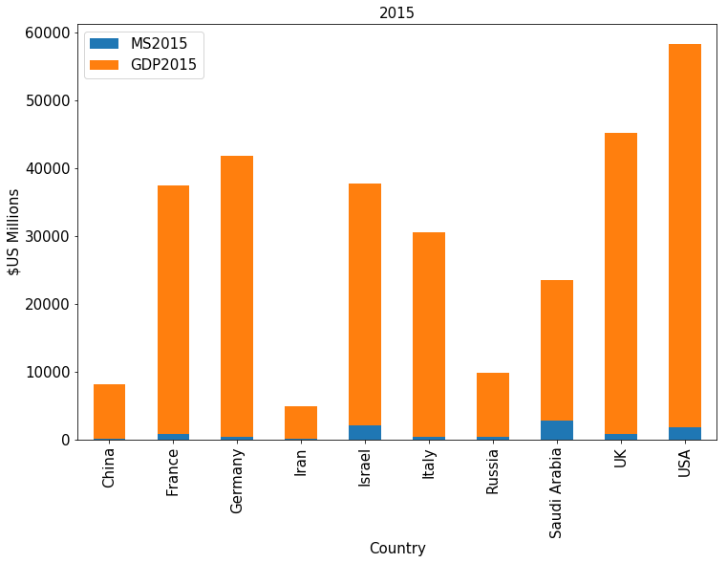

Slide 11
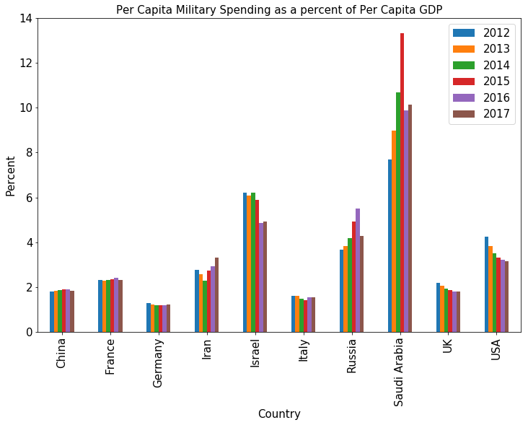
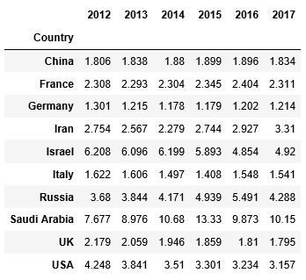
Per capita military spending as a percent of per capita gdp

Slide 12
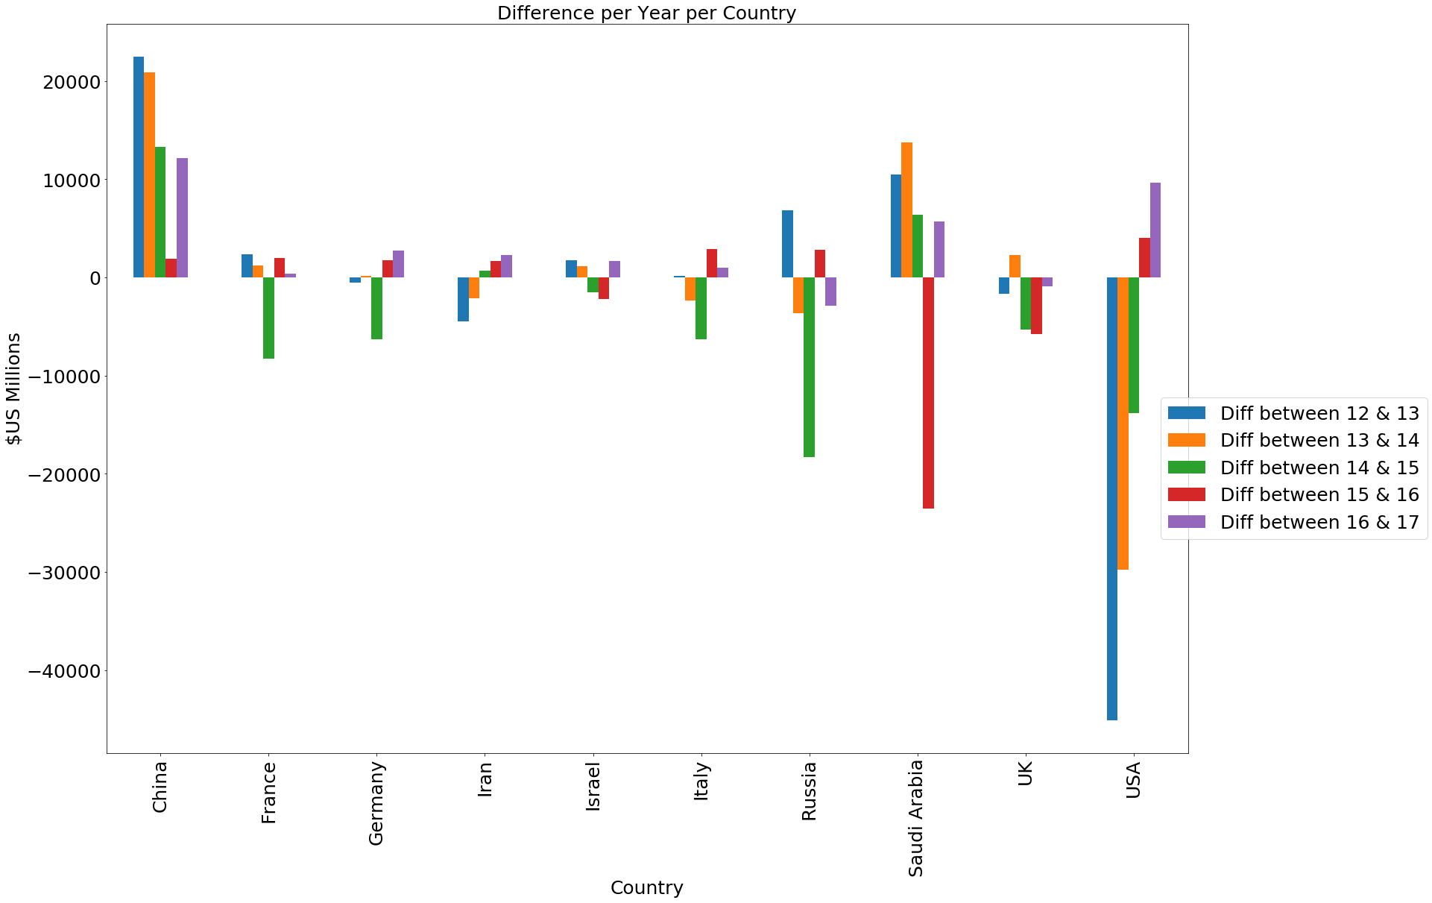
military spending: difference per year -Fixed Value-

Slide 13
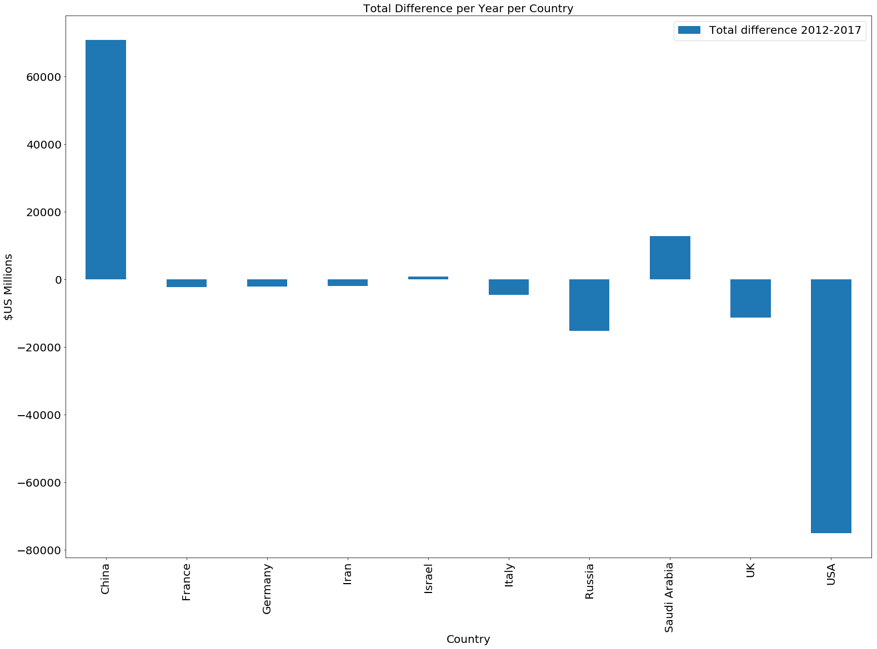
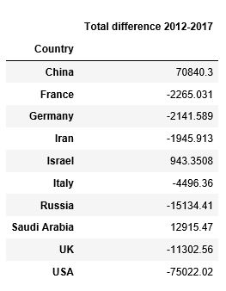
Total difference between 2012-2017 -FIXED VALUE-

Slide 14
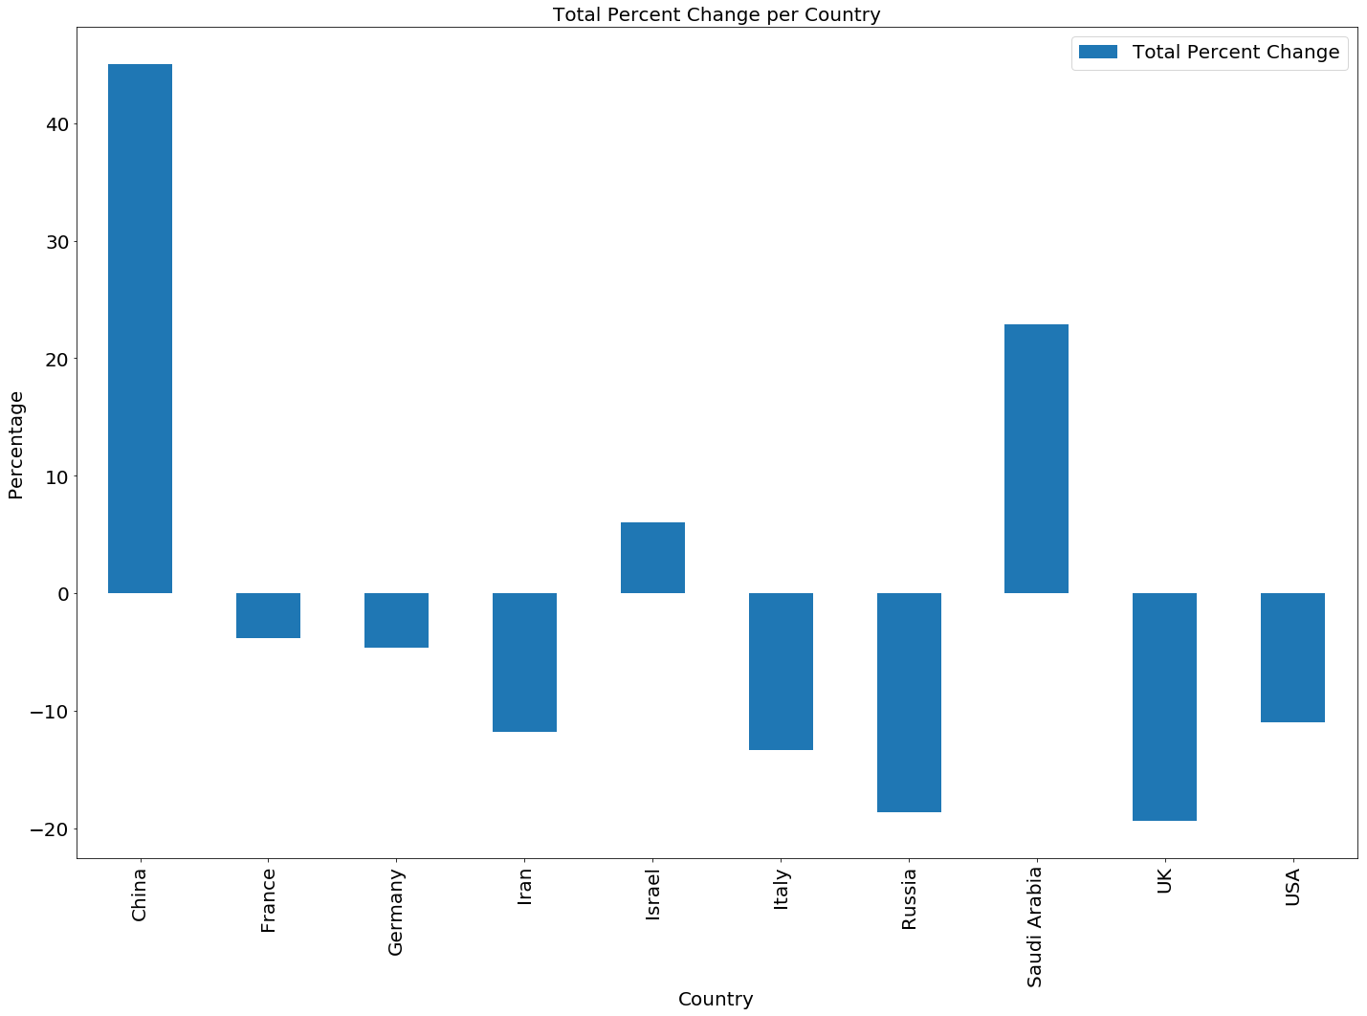
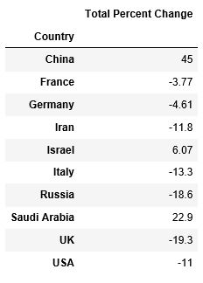
Total difference between 2012-2017 -percent-

Slide 15
Conclusion
Recap
Saudi Arabia spends a large amount of its GDP on Military Spending compared to the other countries, Israel is also quite large.
The United States and China spend the largest amount on the Military out of all of the countries possibly in correlation with their high GDP.
The US is continually decreasing and China is continually Increasing.
Saudi Arabia spends the most on military per capita in comparison to per capita GDP.
Saudi Arabia, Israel and Russia have relatively low GDPs but relatively high Military Spending.
Associations/Correlations and Predictions
China might be spending more money on Military to strengthen their military presence in the East, I predict they will continue to increase spending.
The US has been decreasing military spending possibly due to budgetary cuts, I predict they will continue this trend.
Saudi Arabia might have been spending such a large amount of its GDP on military because of the on going war with Yemen. This was started in 2015- when the spike I noted earlier occurred.
Israel might have been spending more on its military spending due to the conflict in the middle east.

